Slide 1
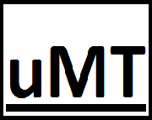
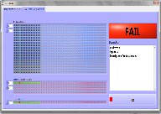
Recover downed machines in minutes!
Universal Machine Troubleshooter© Download it for free at u-MT.com!
Universal Machine Troubleshooter© is an Artificial Intelligence computer based system for automatic diagnosis of the root cause of downed or malfunctioning equipment. By using this program on an automated PLC control, the traditional method of troubleshooting by an experienced technician is replaced with an automated method that dramatically reduces diagnostic time to minutes on failed machines. Scans for automatic diagnosis in any PLC with Modbus TCP/IP protocol or OPC Server UA, enabling its universal diagnosis implementation.
Automatic Troubleshooting by uMT
Save Time and money!
Traditional troubleshooting method
Contact at sales@u-MT.com

